Slide 1

CADx PROJECT (Skin Lesion Classification)
Supervised By
Dr. Xavier Llado
Dr. Arnau Oliver
Kaisar Kushibar
Presented By
Md. Kamrul Hasan
Basel Alyafi
Fakrul Islam Tushar

Slide 2
Outline
Objectives & Materials
Methodology
Results
Conclusions

Slide 3
Objectives
Challenge-1
Challenge-2
nevus
lesion
bcc
bkl
mel

Slide 4
Materials (Image data)
Challenge-1
Challenge-2
Training
nevus (2400)
lesion (2400)
Validation
nevus (600)
lesion (600)
Training
bcc (400)
bkl (800)
Validation
bcc (100)
mel (200)
mel (800)
bkl (200)

Slide 5
Methodology
Overview of the work.

Slide 6

Preprocessing
Architecture Selection
Training & Tuning
Classifier Selection &
Ensembling
Normalization
VGG-16
1st stage Training
Saved Models
VGG-19
Standardization
Ensembling
2nd stage Training
Xception
Segmentation
InceptionV3
Hard Voting
ResNet50
Weighted Voting
DenseNet

Slide 7
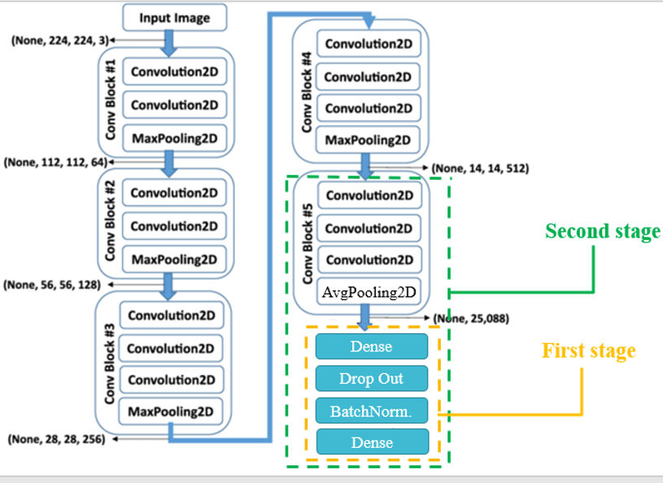
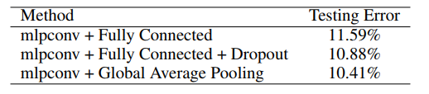
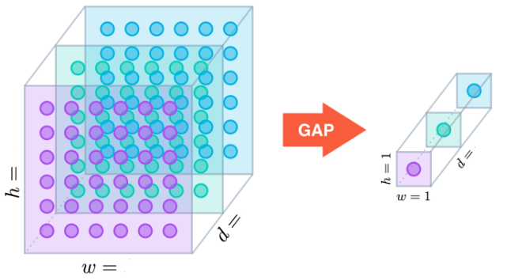
Training & Tuning
Global average pooling compared to FCN [1].
14
512
512
14
Global average pooling [2]
Notes:
[1]. M. Lin et. al. “Network in Network”, 2014.
[2]. https://alexisbcook.github.io/2017/global-average-pooling-layers-for-object-localization/

Slide 8

Challenge-1
1

Slide 9
Experiments-1 on VGG-16
1
Stage | Optimizer | Learning rate | Momentum | Nestrov | Metric | Epochs | Loss
1 | Rmsprop | 1e-3 | - | - | Accuracy | 30 | binary_ crossentropy
2 | SGD | 1e-4 | 0.9 | True | Accuracy | 30

Slide 10
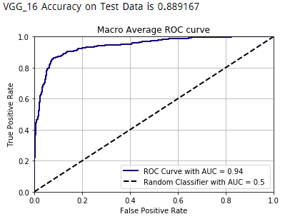
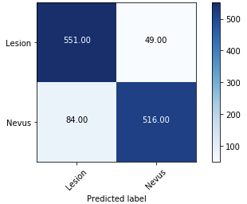
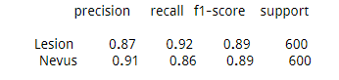
Results Experiment-1
1

Slide 11
Experiments-2 on VGG-16
1
Stage | Optimizer | Learning rate | Momentum | Nestrov | Metric | Epochs | Loss
1 | SGD | 1e-4 | 0.0 | False | Accuracy | 30 | binary_ crossentropy
2 | SGD | 1e-4 | 0.9 | False | Accuracy | 30

Slide 12
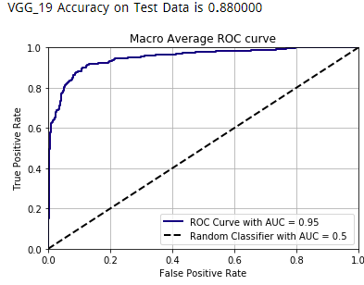
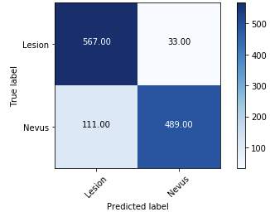
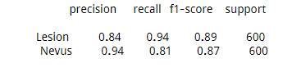
Results Experiment-2
1

Slide 13
Experiments-3 on VGG-19
1
Stage | Optimizer | Learning rate | Momentum | Nestrov | Metric | Epochs | Loss
1 | Rmsprop | 1e-3 | - | - | Accuracy | 30 | binary_ crossentropy
2 | SGD | 1e-4 | 0.9 | True | Accuracy | 30

Slide 14
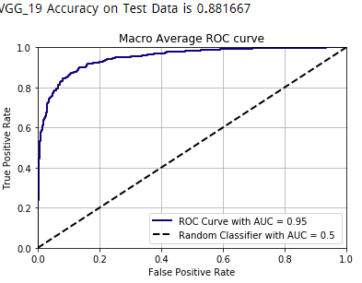
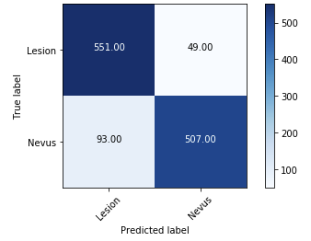
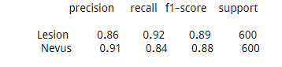
Results for Experiment-3
1

Slide 15

VIVA Democracia
Hard voting:
Count classifiers votes
Weighted voting:
Weigh probabilities by classifiers AUC.
Notes:
Reference: Balas Harangi, “Skin lesion classification with ensembles of deep convolutional neural networks”.

Slide 16
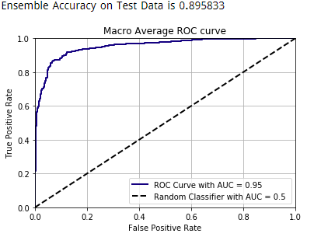
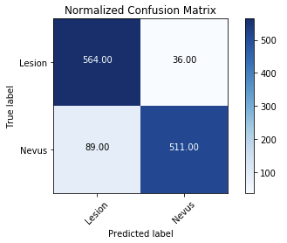
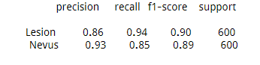
Ensembled CNN Hard Voting
1

Slide 17

Challenge-2
2

Slide 18
Experiments-1 on VGG-16
2
Stage | Optimizer | Learning rate | Momentum | Nestrov | Metric | Epochs | Loss
1 | Rmsprop | 1e-3 | - | - | Accuracy | 30 | categorical_ crossentropy
2 | SGD | 1e-4 | 0.9 | True | Accuracy | 30

Slide 19
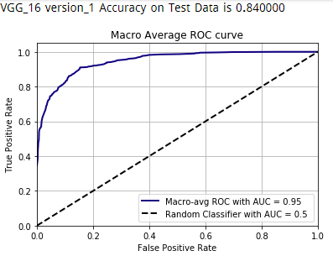
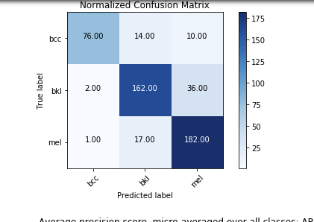
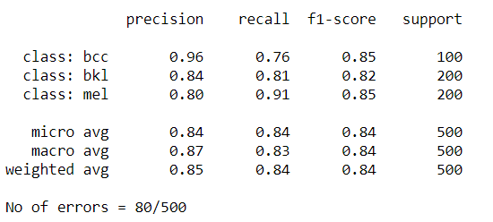
Results Experiment-1
2

Slide 20
Experiments-2 & 3 on VGG-16
2
Exp-2: size-weighted loss function
class_weight={'bcc': 2, 'bkl': 1, 'mel': 1}
Exp-3: standardization instead of normalization

Slide 21
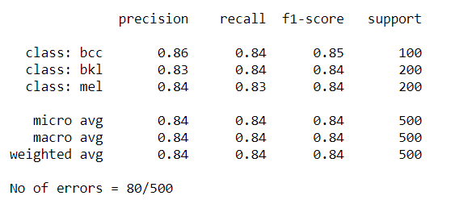
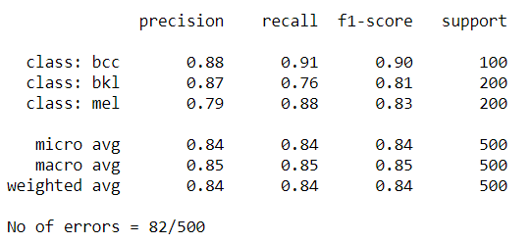
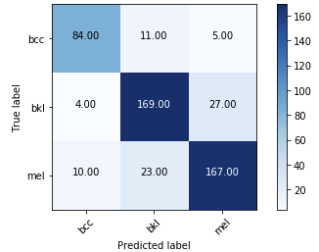
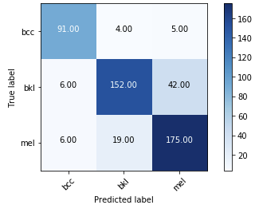
Results Experiment-2 & 3
2

Slide 22
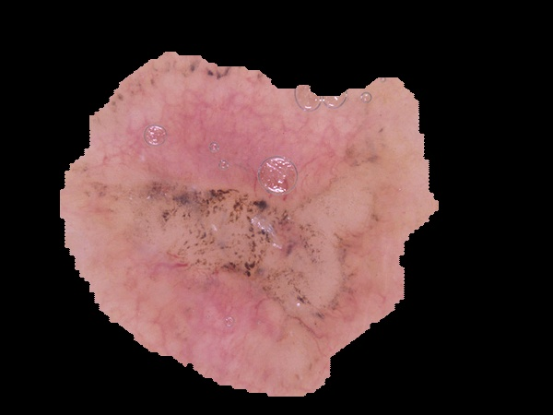
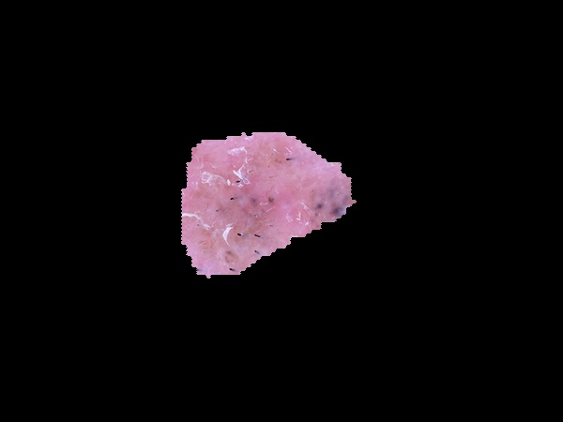
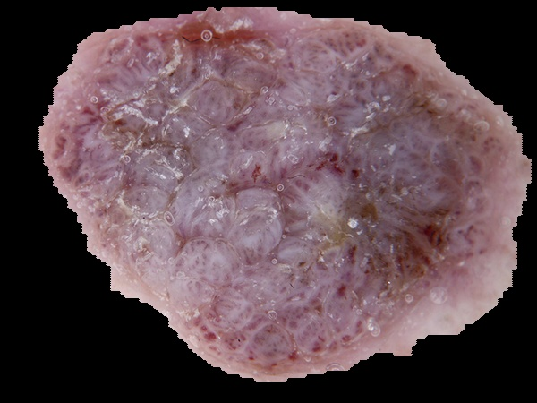
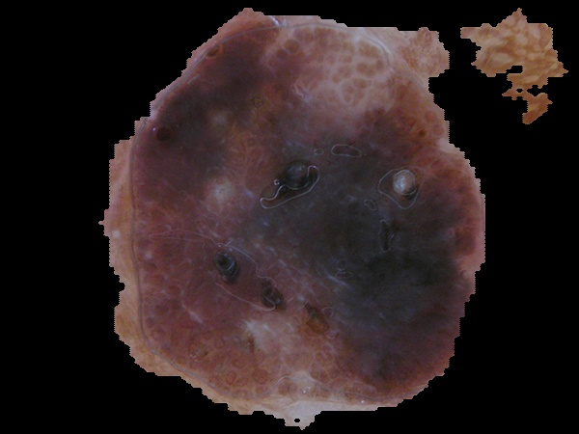
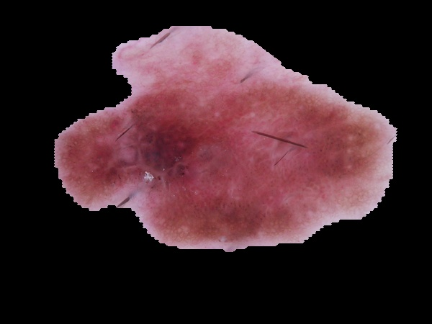
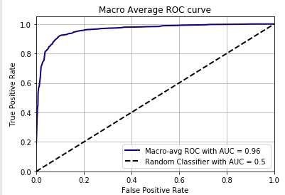
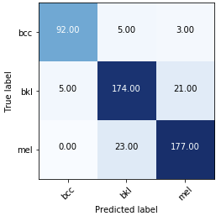
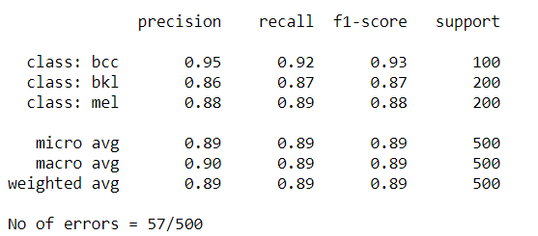
Results Experiment-4
2
3rd Experiment

Slide 23
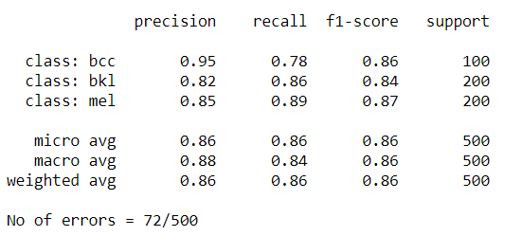
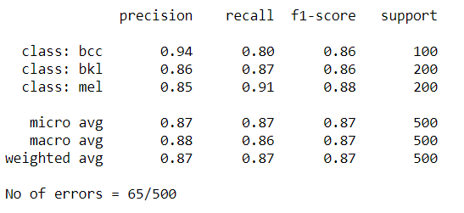
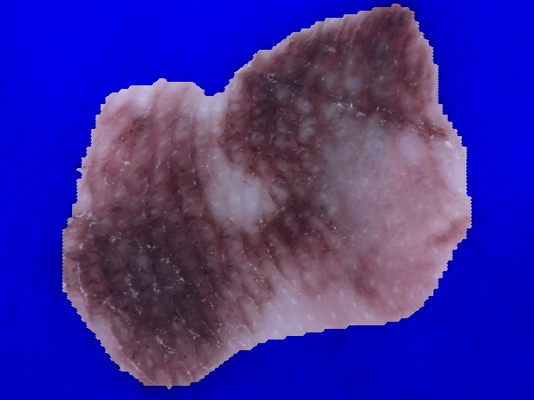
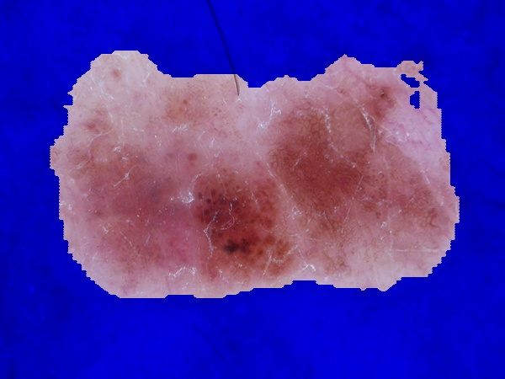
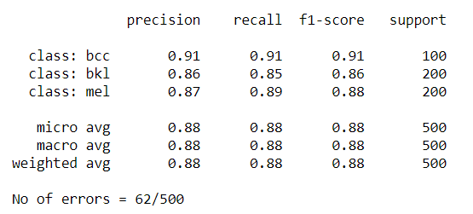
Results Experiment-5 & 6 & 7
2
Exp. 5
Standard. Preprocess
No segmentation
Exp. 6
2000X2
Synthetic input:
Original blue channel only
Synthetic data; (RG) segmented images merged with the original B channel.
Exp. 7
2000X2
Images + seg.

Slide 24
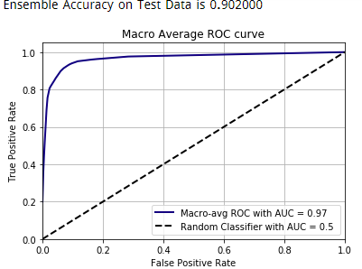
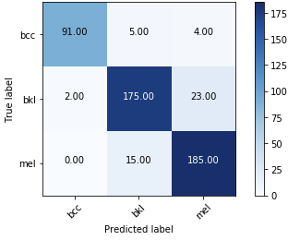
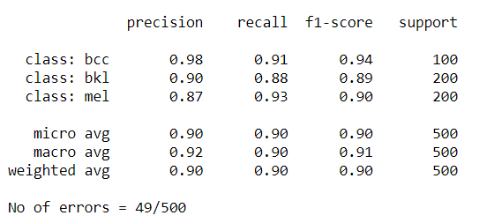
Results Ensembled CNN Hard Voting
2

Slide 25
Conclusions
VGG worked well with the provided data.
GAP is a good regularizer.
In transfer learning, use original preprocessing.
Two-stage training was useful.
Good segmentation helps.
Ensembling is better than single classifiers.
Democracy always wins.

